Slide 1

Overview
Welcome and introductions
What does it mean to eat well?
Shopping habits
Cooking cost effectively
Making the most of food
Review

Slide 2
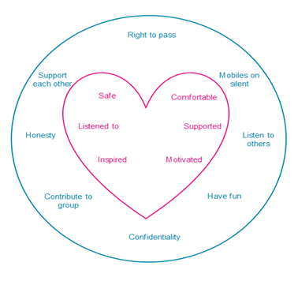
Group guidelines

Slide 3
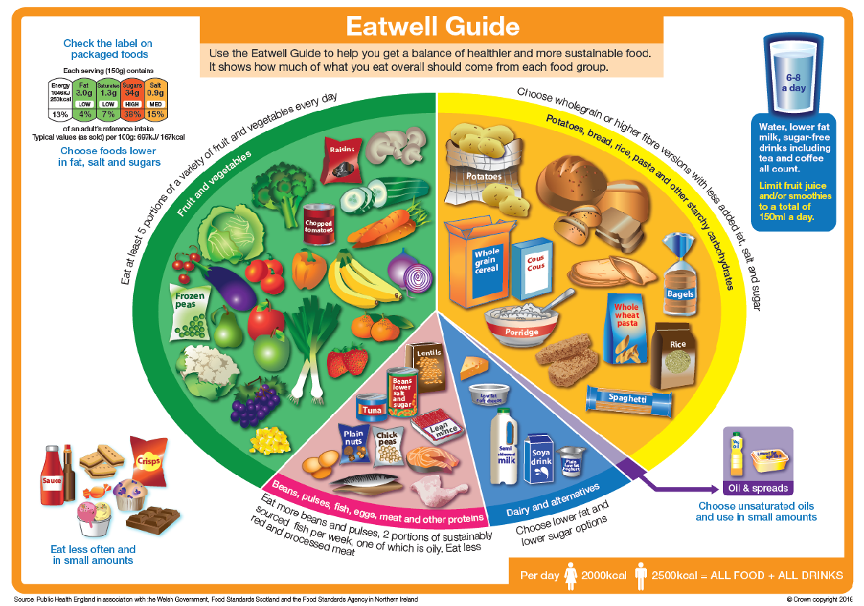

Slide 4
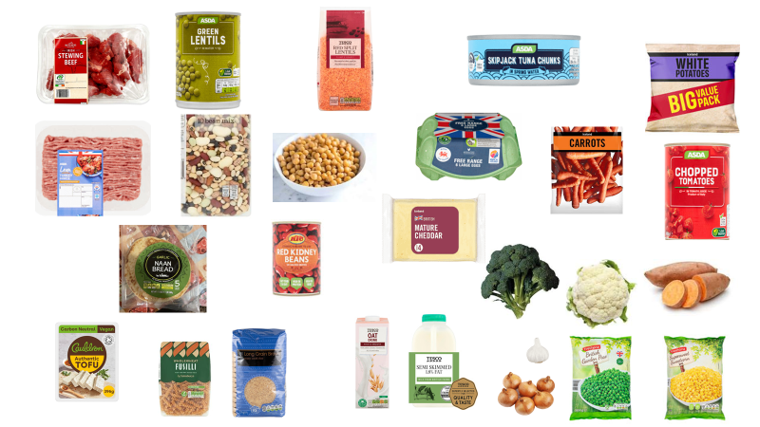
What can we make?

