Slide 1


Overview
Session 1 - What’s a healthy family?
Session 2 - A healthy balance
Session 3 - Understanding children’s behaviour
Session 4 - Being a parent
Session 5 - Healthy swaps
Session 6 - Family mealtimes
Session 7 - Negotiating family agreements
Session 8 - Children growing older

Slide 2
Our Group Guidelines

Slide 3
A Healthy Family
A healthy family

Slide 4
Being a Parent of a Healthy Family
Parent of a healthy family

Slide 5

Boosting our Batteries
BOOSTING
OUR
BATTERIES

Slide 6
Five Ways to Wellbeing
Connect | Be active | Take notice | Keep learning | Give

Slide 7
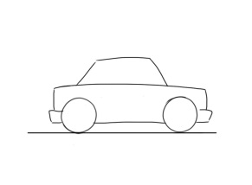
Car Park

Slide 8
Typical Family Meals and Snacks
Typical family meals | Typical family snacks

Slide 9
Ways to Build Self-Esteem
Love | Time and attention | Praise and encouragement

Slide 10
Where and What Children Eat
When our children are not with us…
…where do they eat?
…what do they eat?

Slide 11
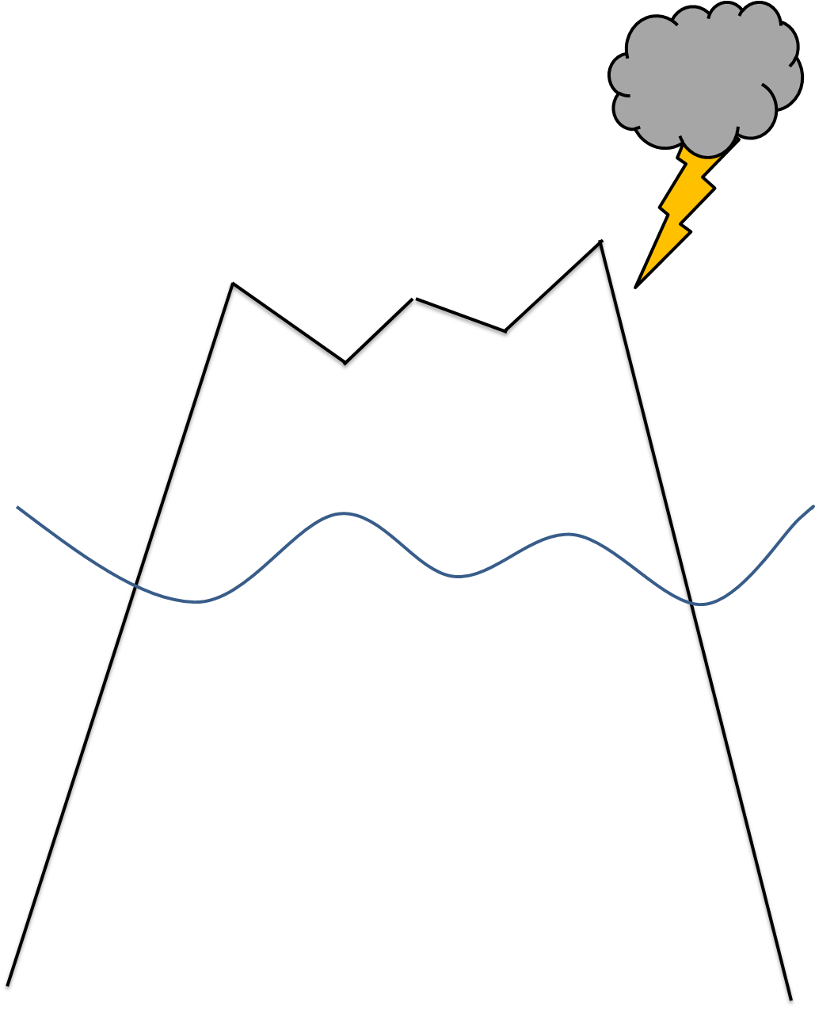
Behaviour, Feelings and Needs

Slide 12
Parenting Styles
D
A
Being in Charge
C
B
Being Responsive

Slide 13
Ideas for Physical Activity
Aerobic activities | Activities that strengthen muscles | Activities that strengthen bones
Dancing Football | Swinging on playground equipment | Hopping

Slide 14
Guided Choice
No choice | Guided choice | Too much choice
We are going to the park. | We are off to the park would you like to walk or ride your scooter? | What would you like to do this afternoon?

Slide 15
Looking at Labels
Name of food/drink product: | Fat | Saturated Fat | Sugar | Salt

Slide 16
Healthy Swaps
Snack/Drink | Healthy Swap

Slide 17
What’s the Question

Slide 18
Family Mealtimes
Family Mealtimes Challenges and Frustrations

Slide 19
Magic Wand – Family Mealtimes
Magic Wand Happy healthy family mealtimes

Slide 20
Solution Spotting
Family Mealtimes
Challenge 1 | Solutions
Challenge 2 | Solutions

Slide 21
The 3 S’s
Sitting
Slowly
Sociably

Slide 22
Lack of Sleep
Lack of Sleep
Parents and Carers | Children

Slide 23
Flying a Kite
What happens when we don’t let out enough string?
What happens if we let out too much string too quickly?

Slide 24
CAR
Child – how the child might be feeling?
Adult – what’s going on for you?
Request – a clear statement of what you’d like to happen next

Slide 25
Why We Eat
Why we eat

Slide 26
Body Image - Messages
Body image messages
Magazines TV programmes Computer games Adverts Social media YouTube Music videos Toys – e.g. dolls Friends Family

Slide 27
Things We Can Say or Do
Things we can say | Things we can do | Things we can do to support ourselves
“You look worried…” | Listen | Get support from others

Slide 28
Changes and Next Steps
Changes made | Next steps

