Slide 1

Group Guidelines
Feelings are at the heart of all behaviour
Right to pass
Listen to others
Share ideas
Safe Valued
Inspired
Not judging
Comfortable Motivated
Ask questions
Confident
Respect other’s opinions
Keep confidentiality
Mobiles on silent

Slide 2
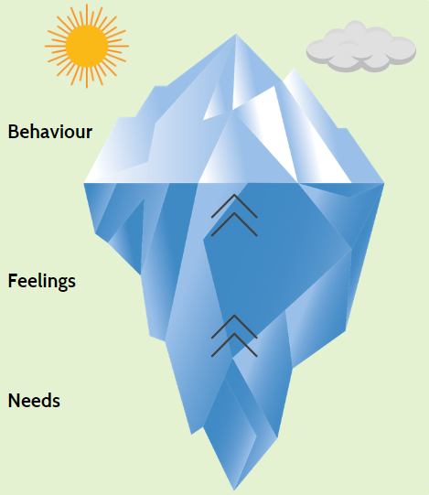
When someone else urges us to make changes to our lifestyle, but we’re not sure we can or even want to ...
Group A

Slide 3
When someone notices what we’re doing wrong, or finds fault with us
Group B

Slide 4
Helpful language Less helpful language

