Slide 1

Online Preparation for Parenthood charts
Session 1
Chart 1 Overview
Chart 2 Group guidelines
Chart 3 Car Park
Chart 4 Strengths and resources
Chart 5 Boosting our batteries
Session 2
Chart 1 Creating a healthy womb environment
Chart 2 Being active
Chart 3 Typical meals/snacks
Session 3
Chart 1 Nest building
Chart 2 What a baby can/can’t do
Chart 3 Iceberg
Chart 4 Building the bond
Session 4
Chart 1 Job description
Chart 2 Typical hazards
Chart 3 Benefits of sleep
Chart 4 Reasons why a baby might cry
Session 5
Chart 1 Let’s focus on feelings
Chart 2 The power of hormones
Session 6
Chart 1 Types of support

Slide 2
Overview
Session 1 – Becoming a parent Session 2 – A healthy pregnancy Session 3 – Bonding
Session 4 – Caring Session 5 – Giving birth Session 6 – Life after birth

Slide 3
Our Group Guidelines

Slide 4

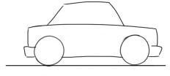
Car Park

Slide 5
Strengths and Resources

Slide 6
Boosting our Batteries

Slide 7



HEALTHY WOMB ENVIRONMENT
Being active Getting enough rest and looking after ourselves Eating well | Better mood/more relaxed | Protects from stress

Slide 8
Daily life at home
Cleaning
To plan into daily life
Going for a walk

Slide 9
Typical meals
Typical snacks

Slide 10
Nest Building
Thinking about my lifestyle and me as a role model, what am I already doing in terms of building the ‘nest’ my baby will be born into?
What changes do I want to make?

Slide 11
I’m a newborn baby and I can.. | I’m a newborn baby and I can’t…

Slide 12
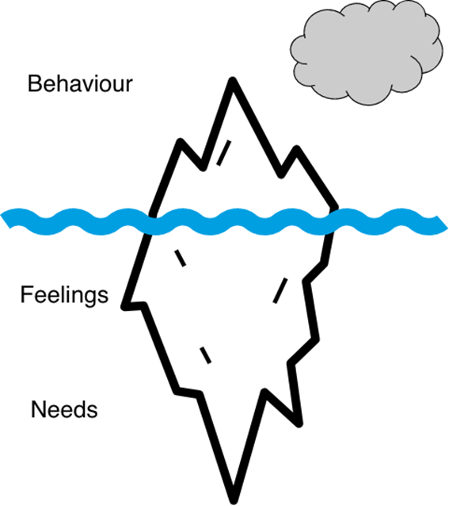
Feelings, Behaviour and Needs
Add text here
Add text here
Add text here

Slide 13
Building the bond
Smiles Skin to skin

Slide 14
Job description

Slide 15
Typical Hazards for Babies
Hazard | How a baby might be exposed to hazard | Ways to prevent and reduce risk
Scalds | Parent spilling hot drink on baby | Avoid hot drink
Falls
Travelling in car
Drowning
Tobacco smoke
Suffocation

Slide 16
Benefits of sleep for babies, parents and family

Slide 17
Reasons why a baby might cry
  hunger
  a dirty or wet nappy
  tiredness
  wanting a cuddle
  wind
  being too hot or too cold
  boredom
  overstimulation

Slide 18


Slide 19
The power of hormones
Hormone | Trigger | Effect | Things we can do
Relaxation (Endorphins) | Pain, exercise, arousal | Natural pain relief, feeling high, focusing inward, well-being | Increase:
Love (Oxytocin) | Comfort, care | Muscle contractions, pleasure | Increase:
Flight or fight (Adrenaline) | Fear, anxiety, stress, fear of losing control | Tension, increased pain, alertness | Decrease:

Slide 20
Types of support – practical, social, emotional
What | Who/Where
Breastfeeding | ‘bump to breast’ group. 1-2-1 support, midwife Health visitor
Meeting other parents | WhatsApp group/zoom calls
feeling low | Talk to a friend, midwife, GP

