Slide 1

Overview
Welcome and introductions
A whole new experience for parents and carers too
How do I know my baby is ready for solids?
Getting started
Starting solids safely
Helping your baby enjoy a wide range of tastes and textures
Review and next steps

Slide 2
Group guidelines

Slide 3

3 things your baby needs to be able to do
Stay in a sitting position and hold their head up unsupported
Pick food up and put it in their mouth by themselves
Move food to the back of their mouth and swallow it

Slide 4
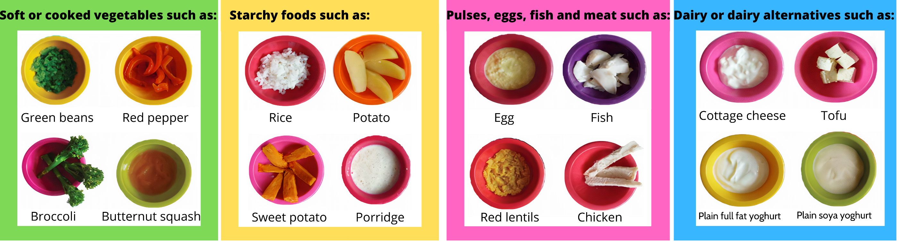
Foods to start with

Slide 5
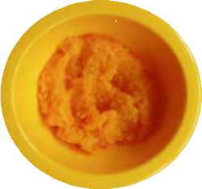
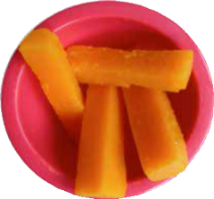
Spoon or finger foods? Be guided by your baby
Smooth
Soft or cooked food
Puréed and mixed with a little breast milk, or infant formula, or cow’s milk from 6 months, if necessary
Mashed
Soft or cooked foods
Mashed with a fork and mixed with a little breast milk or infant formula, or cow’s milk from 6 months, if necessary
Finger foods
Start with soft or cooked vegetables
Remove any pips, stones, tough skin or stringy bits
Cut into sticks, long enough for your baby to grip in their fist

Slide 6
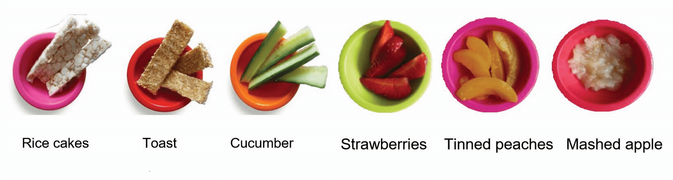
Follow-on foods

Slide 7
Starting solids safely

